Slide 1
ActionDirector Mobile v2.12 Proposal
PM: Elvis Chen

Slide 2
V2.12
Schedule
Scope
6/13 GM
Selling contents
Color preset
Sticker
Title
Transition
Web based store
Refer to PHD’s design
Subscription model
Remove downloaded contents

Slide 3
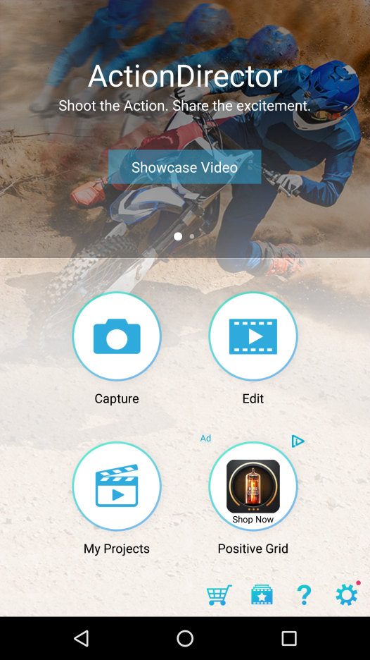
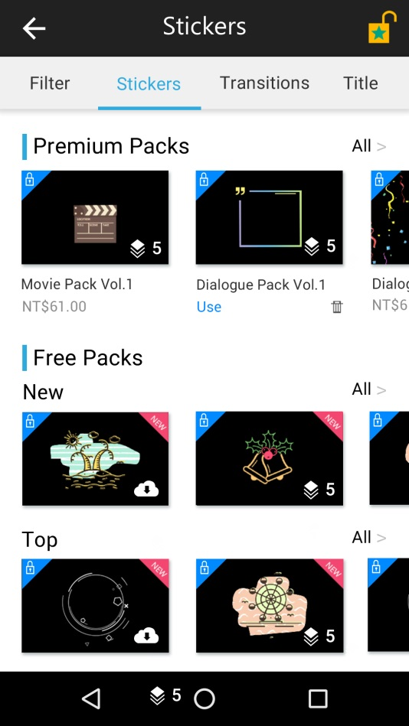


Web Based Store
Unlock all: Tap to pop up subscription dialog
4 categories to switch
New entry from home page

Slide 4
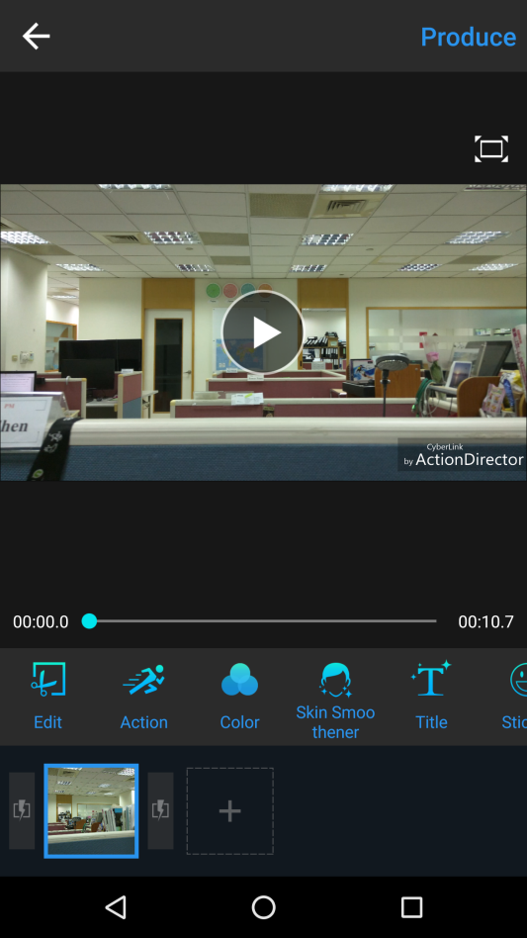
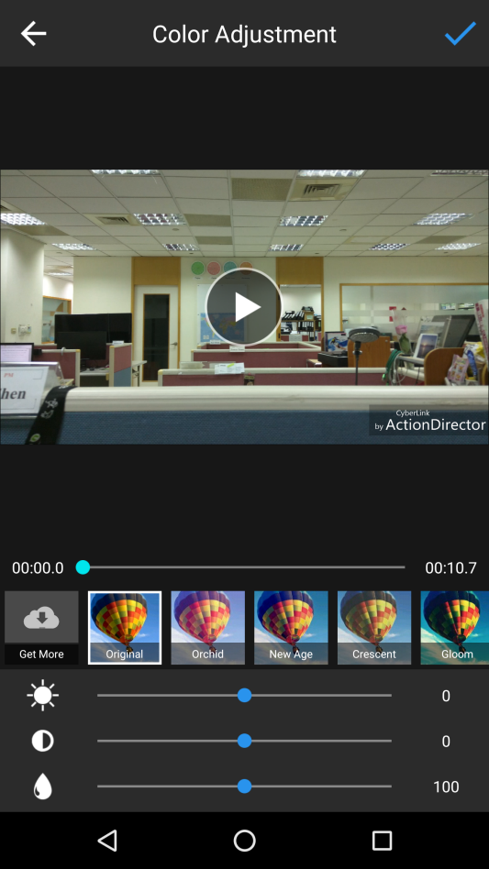
Selling Content: Color Preset

Slide 5
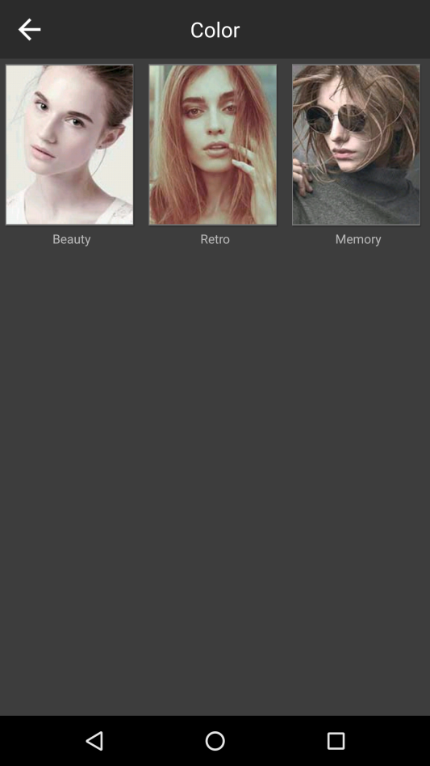
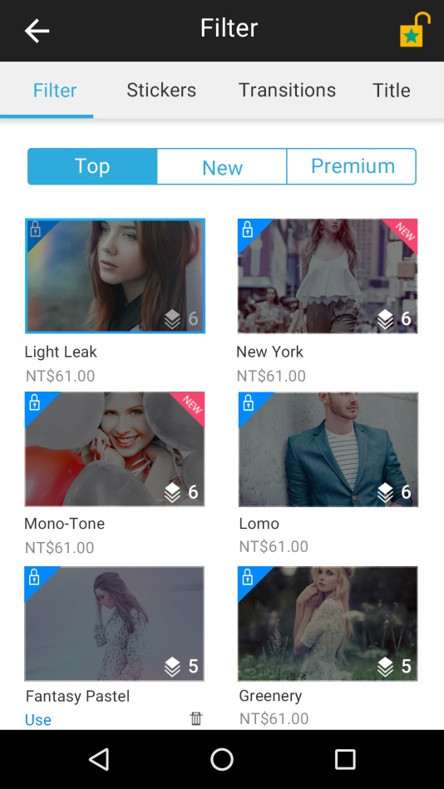
Selling Content: Color Preset
Current
Web based

Slide 6
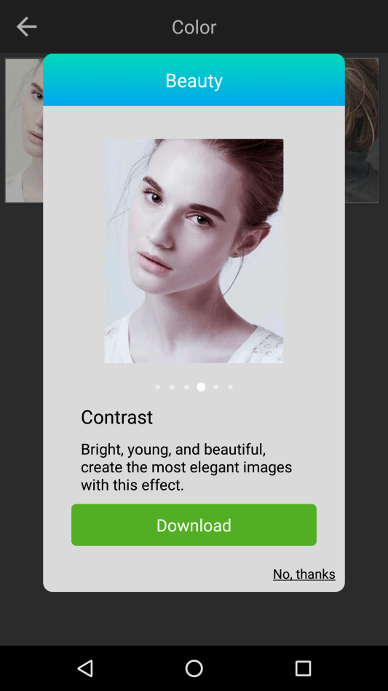
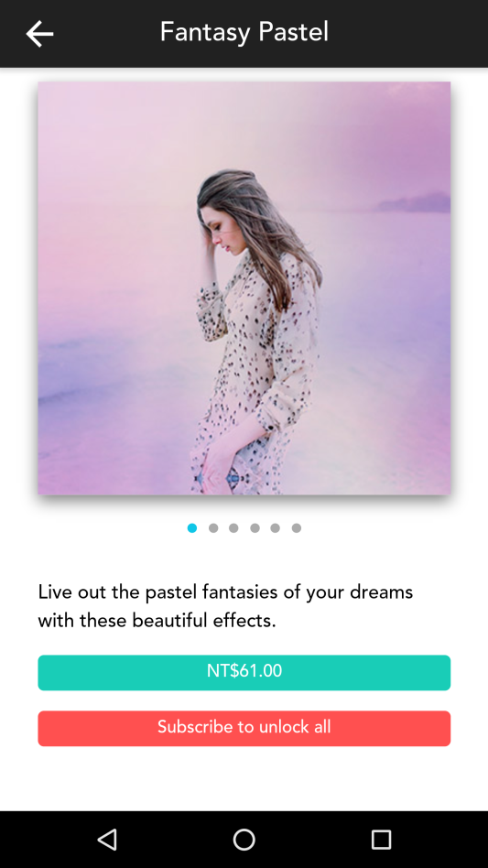

Selling Content: Color Preset
Current
Web based
For downloaded sticker, show a button to delete it
If user purchased the IAP content, show “Purchased”
Purchased
If user subscribed, hide the button.

Slide 7
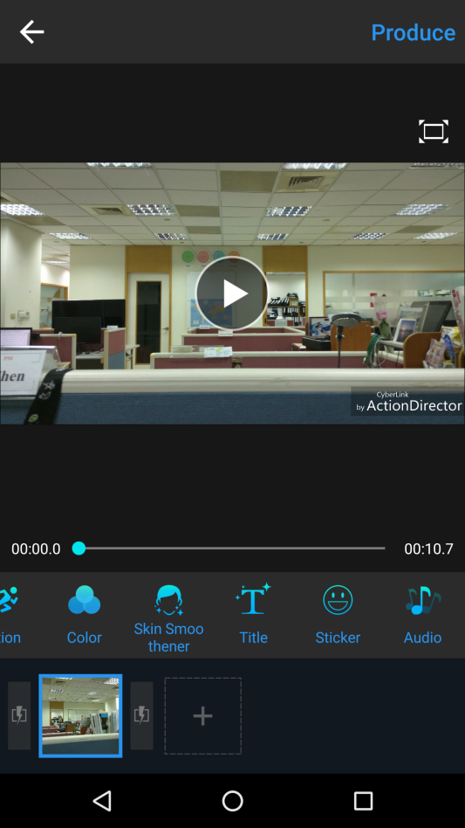
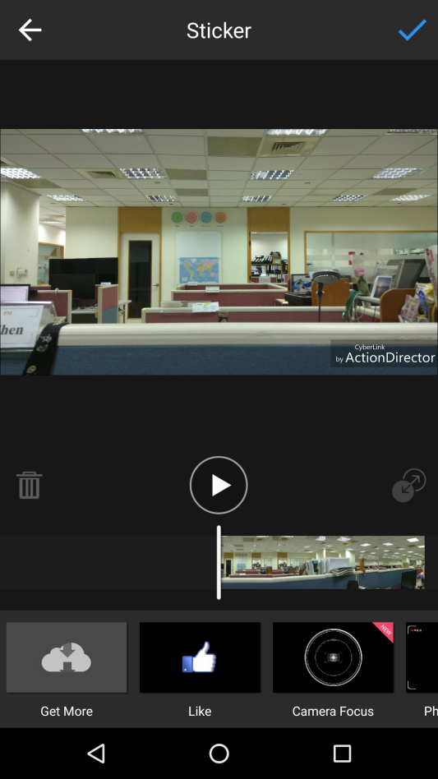
Selling Content: Sticker

Slide 8
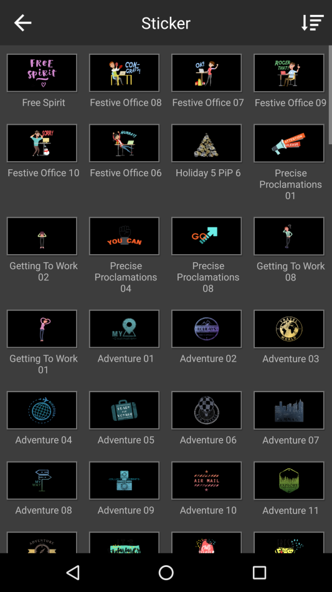
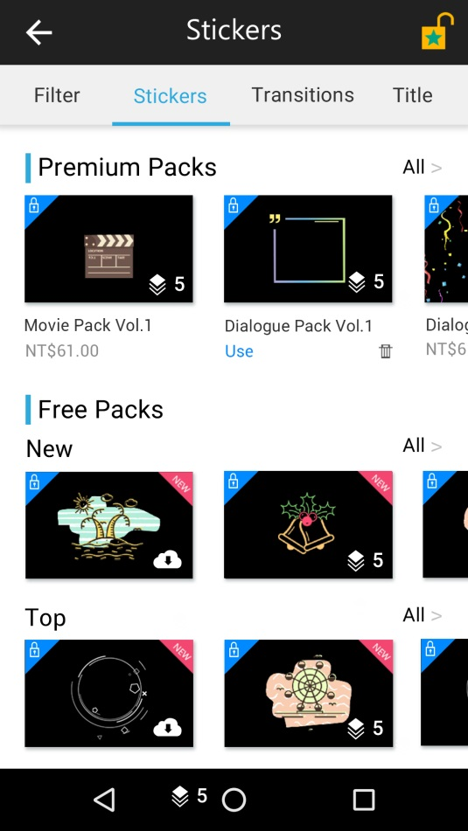
Selling Content: Sticker
Unlock all: Tap to pop up subscription dialog
Current
Web based
Premium pack has independent category and sort by time
Premium pack has the icon to show how many stickers per pack
Scroll left<->right
Tap to download free sticker
Show the IAP price
For downloaded sticker, has a button to delete it
Free stickers are sorted by time and download count
Free stickers are all single template, not a pack.
Tap to download free sticker

Slide 9
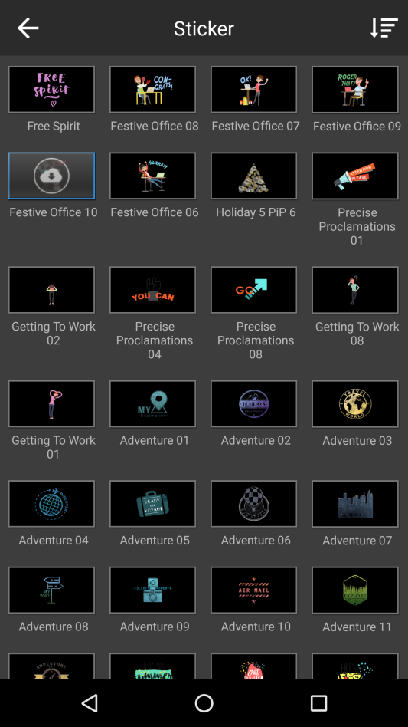
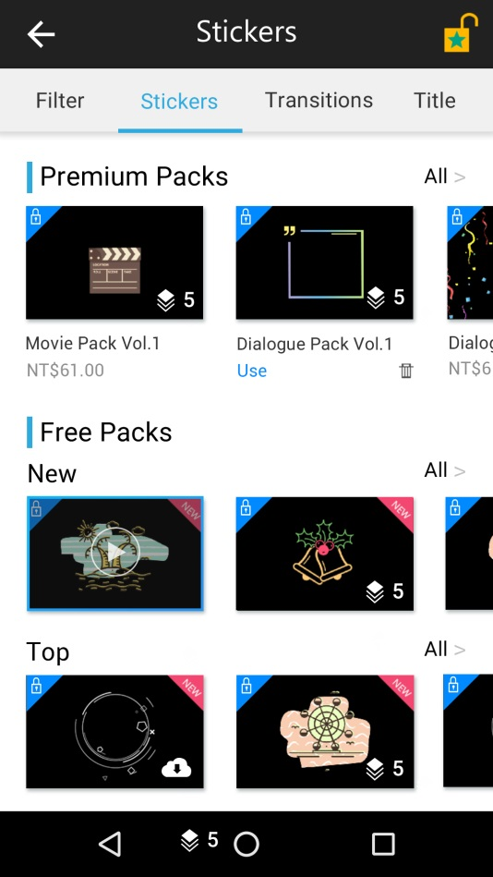
Selling Content: Sticker
Current
Web based
User may preview it after downloading
User may preview it after downloading

Slide 10
Selling Content: Sticker
Current
Web based
Tap to show all

Slide 11
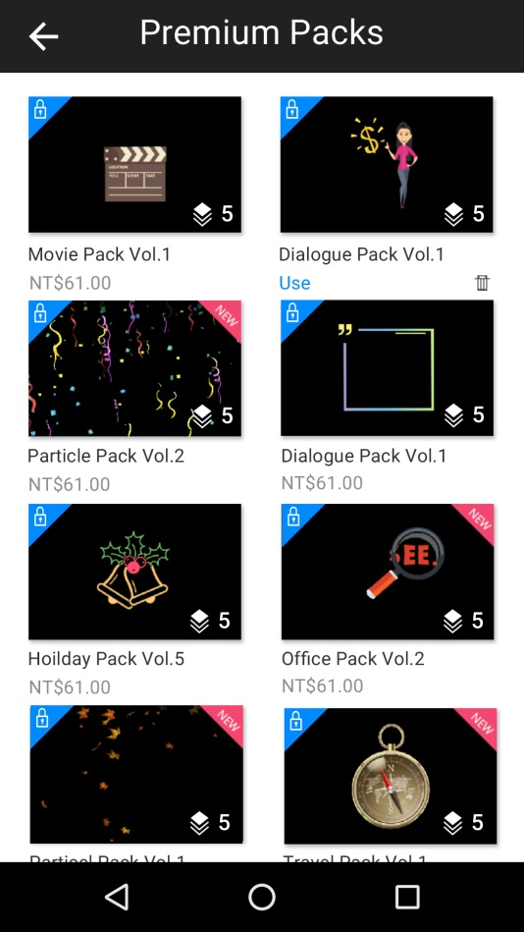
Selling Content: Sticker
Current
Web based
Tap a premium pack to IAP dialog

Slide 12
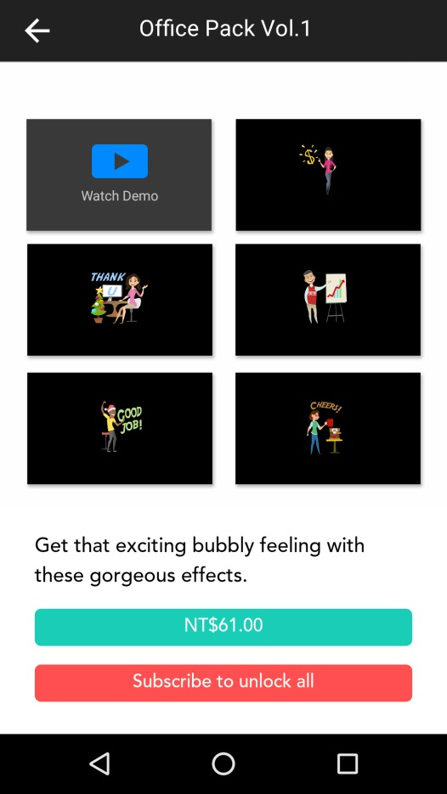
Selling Content: Sticker
Tap to show demo video (from YouTube)

Slide 13
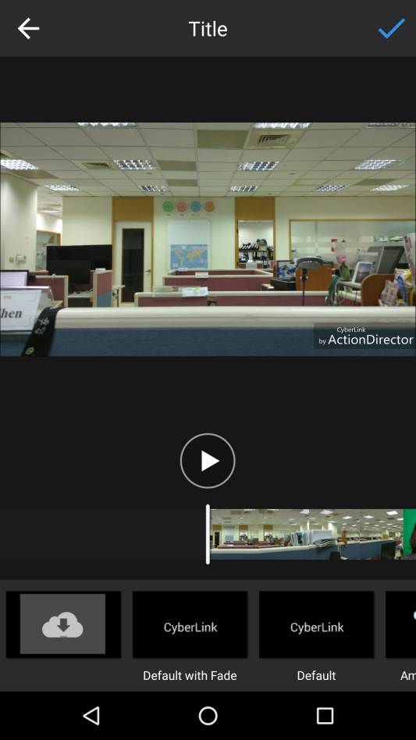
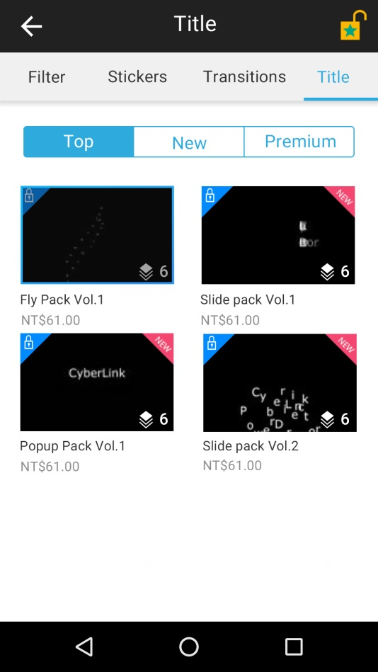
Selling Content: Title
Tap a premium pack to IAP dialog
Get more

Slide 14
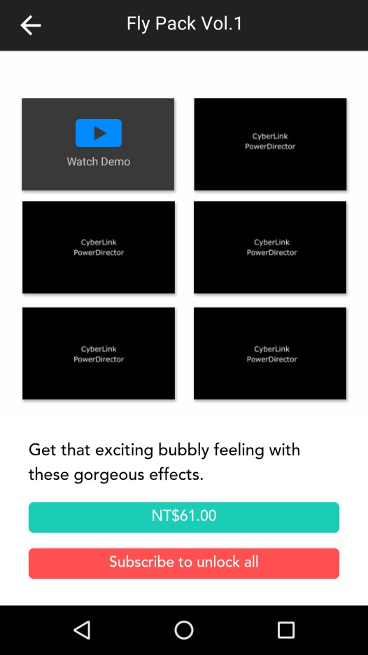
Selling Content: Title
Tap to show demo video (from YouTube)

Slide 15
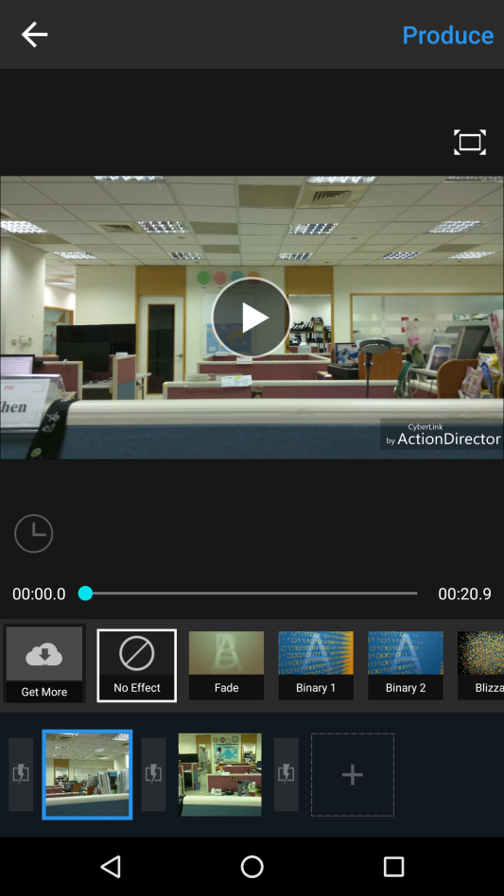
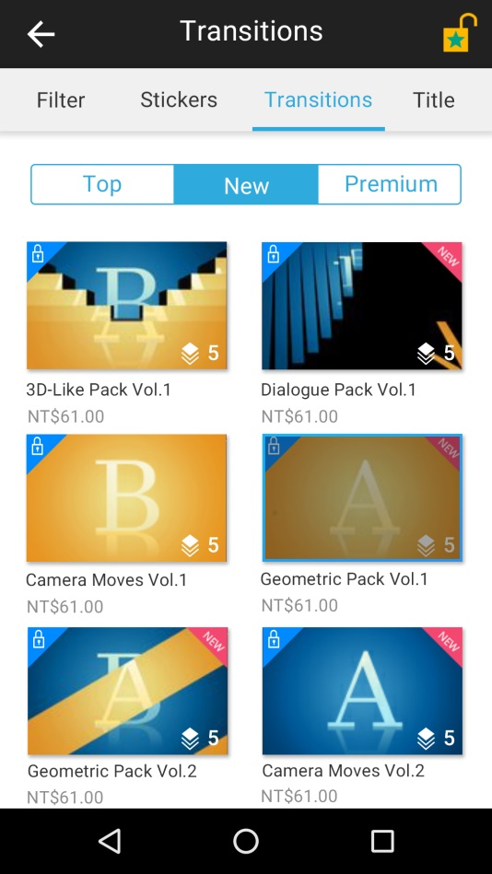
Selling Content: Transition
Tap a premium pack to IAP dialog

Slide 16
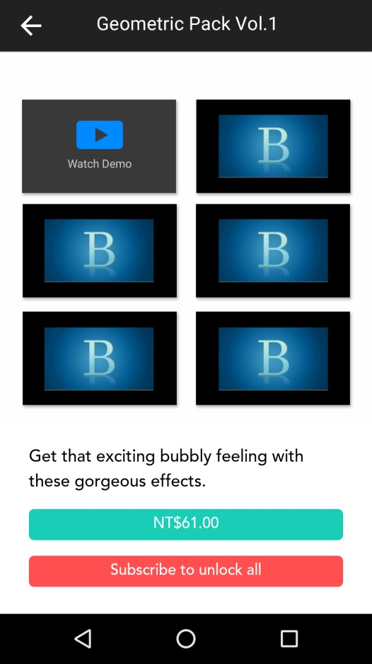
Selling Content: Transition
Tap to show demo video (from YouTube)

Slide 17
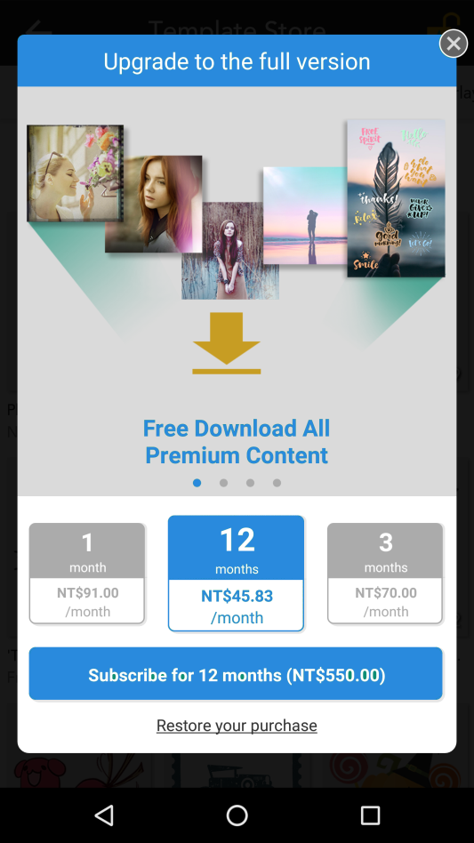
Subscription model
Features:
FullHD & 4K output
Remove watermark
Remove ads
Download all premium content

Slide 18
Remove Downloaded Contents
Behavior
Refer to U stickers

